Slide 1


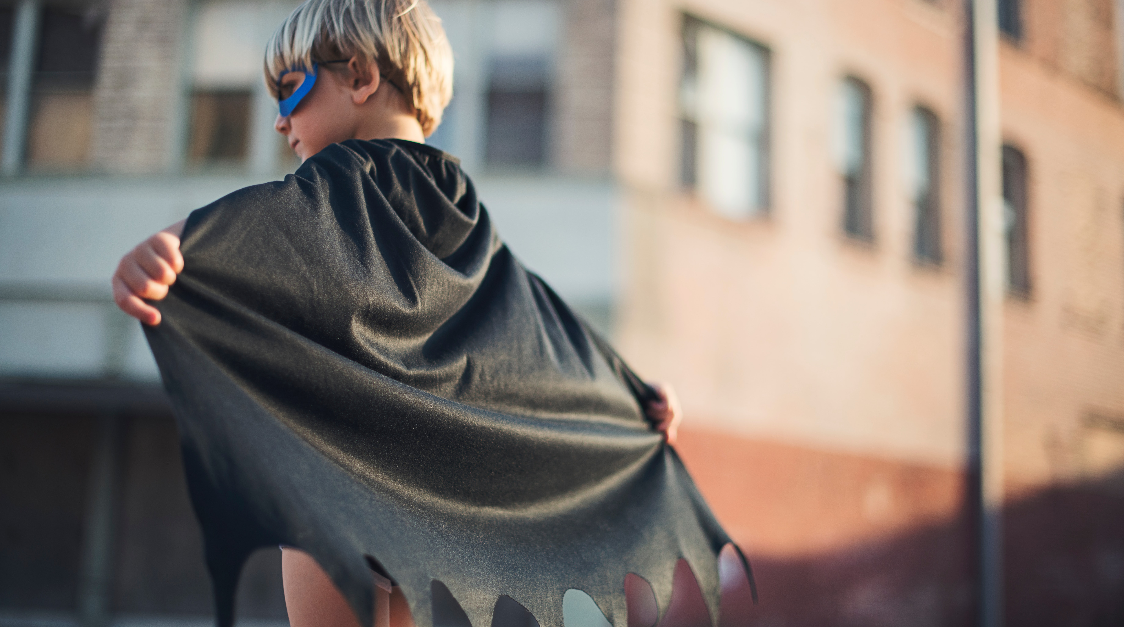
Heroes of the Heart
LES Multiversity
March 17, 2023
Photo by TK on Unsplash

Slide 2
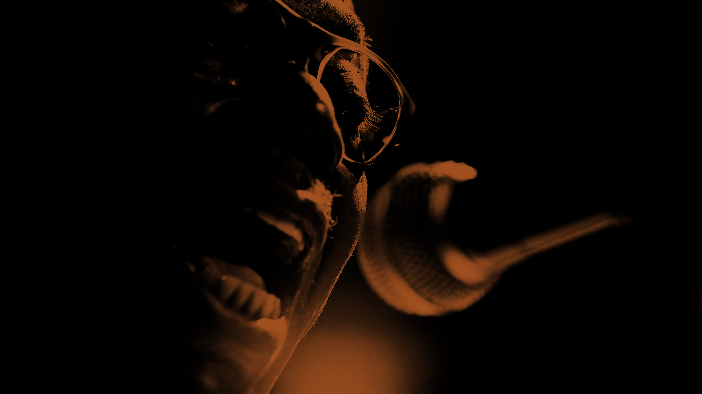
We ARE FAKES
Click to add photo
News
Religion
Work/Career
Gross Domestic Product (GDP)
Governance
Relationships
Education
Products

Slide 3
Being Authentic
Life is interconnected and interdependent
Learning from our Body
Nobody should be in need
The seven heroes
Photo by Claudio Schwarz on Unsplash

Slide 4

Compassion is
a mind that
removes the suffering that is present in
the other
‘Compassion’ means ‘to endure something with another person’ feel her pain as though it were our own
We have inoculated ourselves
We have become hardened.
THICH NHAT HANH

Slide 5
Embryo of Compassion stirring to be born
Life has become hardened
Dictatorial Governments
Hard quantitative science skills
Hard cement
Hard Gaze
Hardened relationships
Trungpa Rinpoche

Slide 6
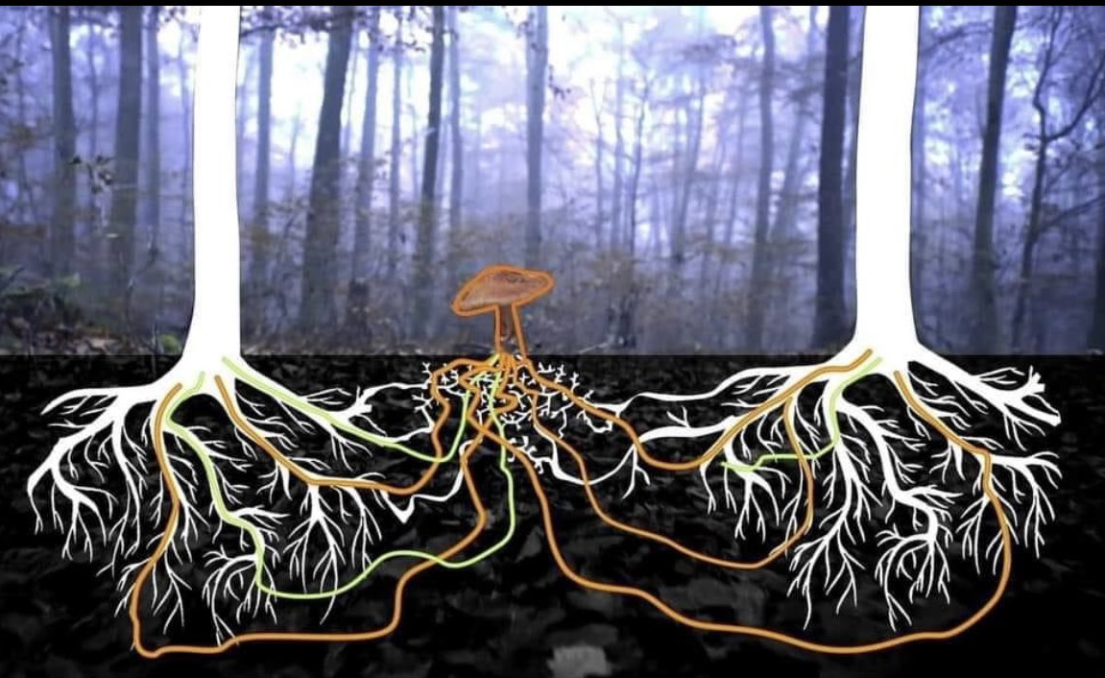
Eco system
The trees and fungi need each other to survive.
Underground network of fungi and trees helping one another protects the health of the entire ecosystem.
We cannot allow anybody to suffer alone
Photo by Brian Roemmele

Slide 7

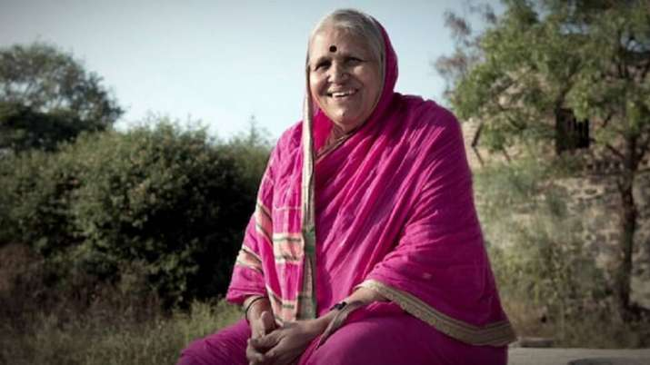
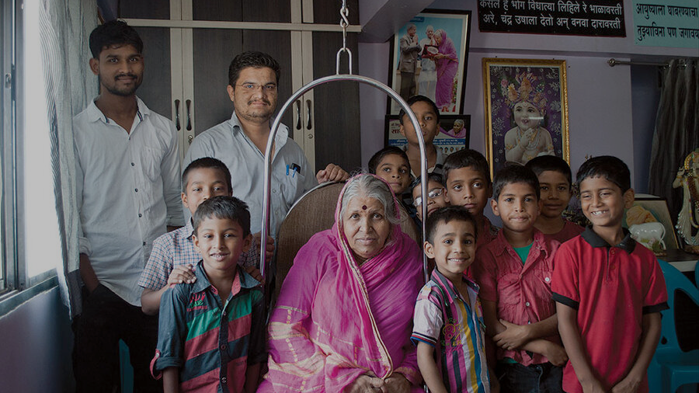
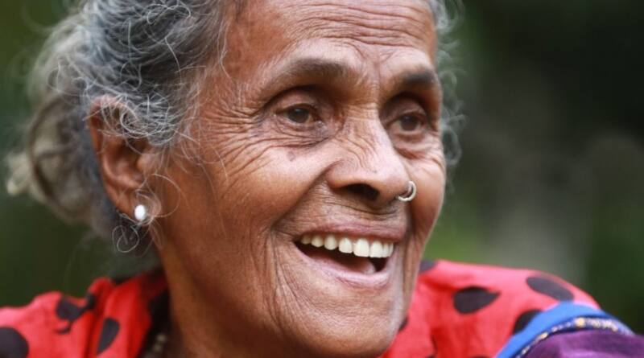
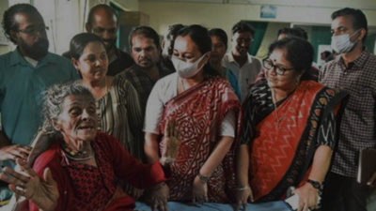
Ms. Sindhutai Sapkal
Daya Bai

Slide 8

Salute the 7 winners of this year’s Heroes of the Heart award
Beginning of a movement
Photo by Matt Duncan on Unsplash

Slide 9

The world will get transformed only through compassion
Martin Luther King Jr.

Slide 10

Thank you
Conrad Saldanha
Photo by Clark Tibbs on Unsplash

